Slide 1
www.LifePortal360.com
Jeff Wallk

Slide 2
What are the opportunities ?
Increasing need for capturing knowledge from an ever increasing list of sources.
Change is accelerating !
People need a way to keep up with each other (family, friends, and those who’ve passed on)
We need to find ways to remove complexity in people’s lives (even though technology & information is exploding…)
Need to resolve the issues with information overload while improving overall knowledge

Slide 3
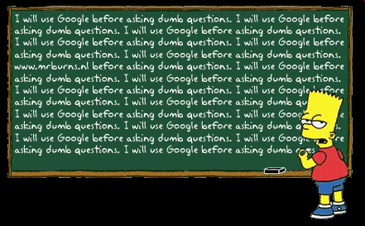
Questions ?

